Slide 1
DOCKER & AWS cloud
Install Docker On EC2 And Explore The Docker Commands…….

Slide 2
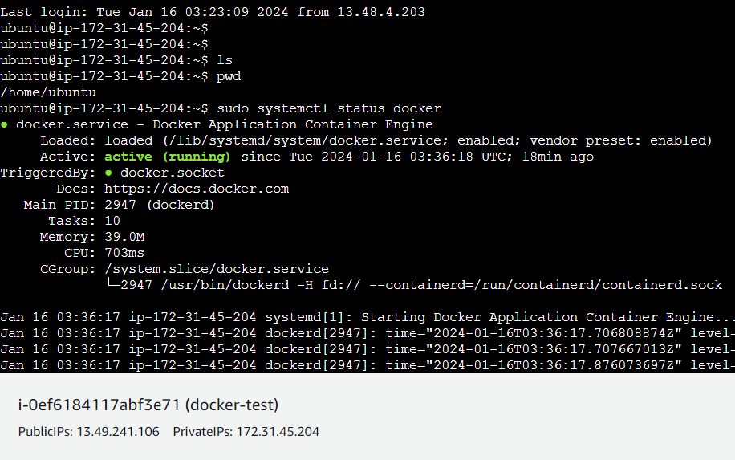
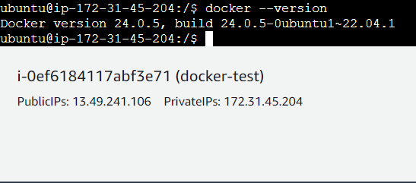
Docker Install Commands
sudo apt update -y
sudo apt-get update
sudo apt-get install docker.io -y
sudo systemctl start docker
sudo systemctl status
sudo systemctl enable docker
docker --version

Slide 3
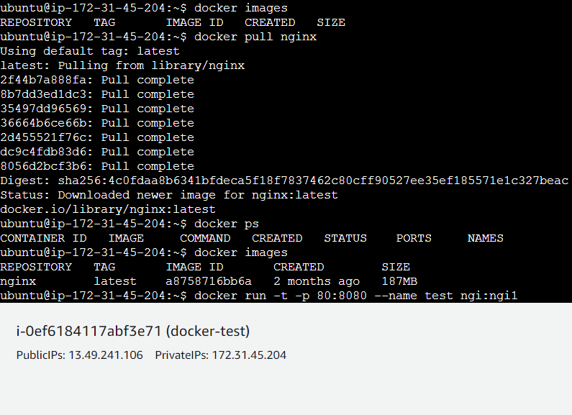
Docker Image vs Container
docker pull name
docker images
docker ps –a
docker run -d -p 8081:80 --name test1 sss:s1
docker stop container-id
docker rm container-id
docker rmi image-name
docker restart container-id

Slide 4
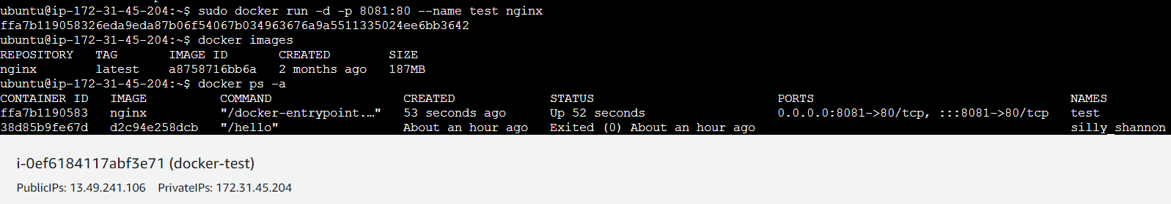
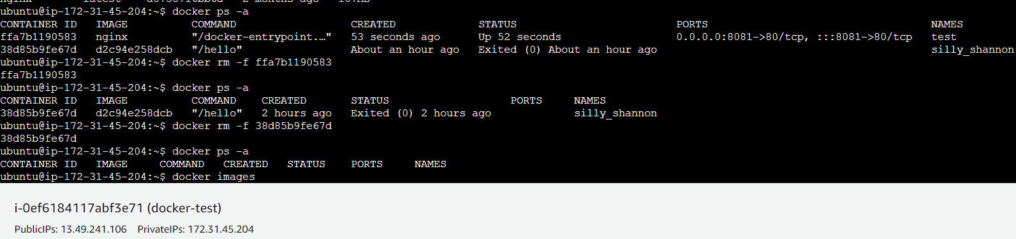
More Info

Slide 5
Thank You
Docker overview
Docker is an open platform for developing, shipping, and running applications. Docker enables you to separate your applications from your infrastructure so you can deliver software quickly. With Docker, you can manage your infrastructure in the same ways you manage your applications. By taking advantage of Docker's methodologies for shipping, testing, and deploying code, you can significantly reduce the delay between writing code and running it in production.
AWS overview
Build, Deploy, and Manage Websites, Apps or Processes On AWS Secure, Reliable Network.
Sign Up for a Free Account & Experience AWS Secure, Reliable, Scalable Services. In-Memory Caching.
Secure Solutions. Global Infrastructure.
{ GokulSM }
Notes:
In Slide Show mode, click the arrow to enter the PowerPoint Getting Started Center.

